Slide 1


COURSE NAME :
Database Management System
COURSE CODE:
CSE311
Submitted To
Nusrat Khan
Lecturer
Department Of CSE
Daffodil International University

Slide 2




JOINS

Slide 3
OUR TEAM
Mosabbir Hossen Maruf
Shahriar Imtiaz Limon
0242310005101182
0242310005101283
Md. Mahidul Islam
Md. Tamim Islam
0242310005101289
0242310005101285
Tanbir Hasan Jewel
0242310005101178

Slide 4


TABLE OF CONTENTS
INTRODUCTION
TYPES OF JOINS
ADVANTAGES
DISADVANTAGES
CONCLUSION

Slide 5


INTRODUCTION
In a Database Management System (DBMS), a JOIN is used to combine rows from two or more tables based on a related column. It helps retrieve meaningful data by connecting different tables that share common keys. Commonly used in SQL queries to extract useful information from relational databases.

Slide 6


INNER JOIN
FULL JOIN
TYPES OF JOINS
LEFT JOIN
RIGHT JOIN

Slide 7
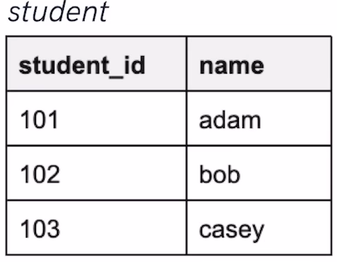
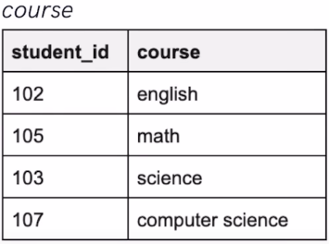
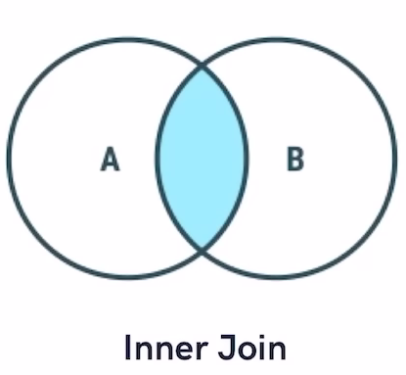
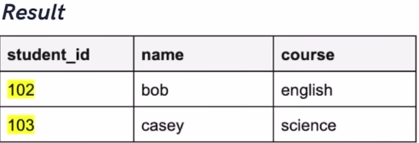
INNER JOIN
RETURNS ONLY ROWS WITH MATCHING VALUES IN BOTH TABLES.
QUERY- SELECT * FROM STUDENT INNER JOIN COURSE ON STUDENT.STUDENT_ID = COURSE.STUDENT_ID;

Slide 8
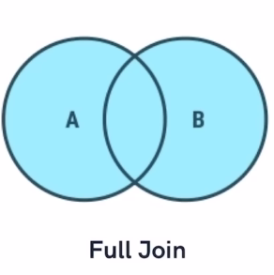
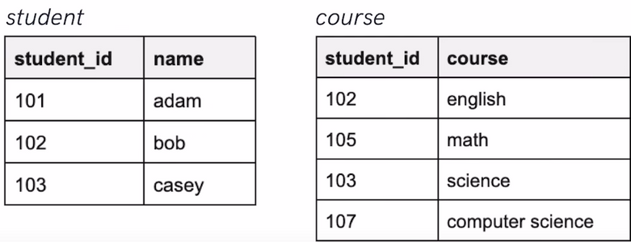
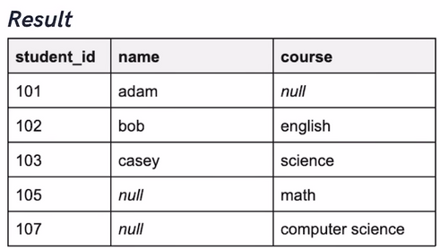
FULL JOIN
RETURNS ALL ROWS WHEN THERE’S A MATCH IN EITHER TABLE, WITH NULLS FOR NON-MATCHING PARTS.
QUERY- SELECT * FROM STUDENT LEFT JOIN COURSE ON STUDENT.STUDENT_ID = COURSE.STUDENT_ID UNION SELECT * FROM STUDENT RIGHT JOIN COURSE ON STUDENT.STUDENT_ID = COURSE.STUDENT_ID;

Slide 9
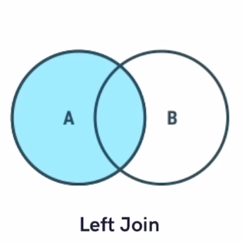
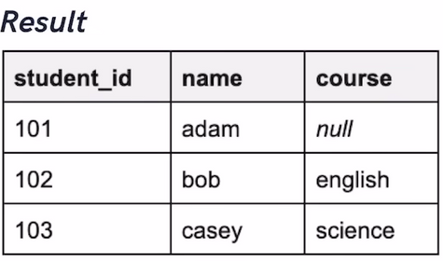
LEFT JOIN
RETRIEVES ALL ROWS FROM THE LEFT TABLE PLUS MATCHING ROWS FROM THE RIGHT, FILLING WITH NULLS WHERE NO MATCH EXISTS.
QUERY- SELECT * FROM STUDENT LEFT JOIN COURSE ON STUDENT.STUDENT_ID = COURSE.STUDENT_ID;

Slide 10
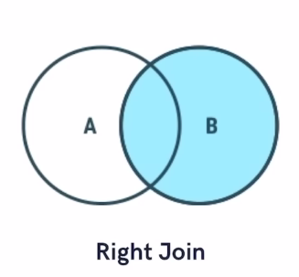
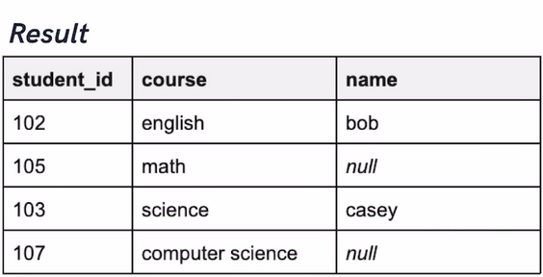
RIGHT JOIN
RETRIEVES ALL ROWS FROM THE RIGHT TABLE PLUS MATCHING ROWS FROM THE LEFT, FILLING WITH NULLS WHERE THERE’S NO MATCH.
QUERY- SELECT * FROM STUDENT RIGHT JOIN COURSE ON STUDENT.STUDENT_ID = COURSE.STUDENT_ID;

Slide 11

ADVANTAGES
EFFICIENT DATA RETRIEVAL
SIMPLIFIES QUERIES
Fetches related data in a single query, reducing multiple queries.
Makes queries more readable and structured.
REDUCES DATA REDUNDANCY
IMPROVES DATA INTEGRITY
Maintains consistency by using foreign keys.
Prevents storing duplicate information across tables.

Slide 12
DISADVANTAGES
COMPLEXITY
MEMORY USAGE
Joins can be difficult to understand and implement for beginners
Requires more processing power, especially with multiple joins.
PERFORMANCE ISSUES
INDEX DEPENDENCE
Large datasets with complex joins may slow down query execution.
Poor indexing can significantly degrade performance

Slide 13


CONCLUSION
The JOIN operation in DBMS integrates data from multiple tables, supporting normalization and reducing redundancy. It enables efficient reporting and analysis by structuring relevant data while optimizing query performance.

Slide 14




THANK YOU

